Slide 1
Tracking And Control
Earned Value Analysis

Slide 2
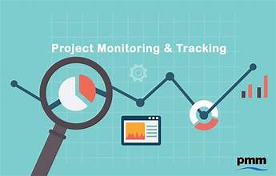
Tracking and Control in Project Management:
Tracking and control are essential components of project management that ensure a project stays on track to achieve its objectives within the allocated time, budget, and scope.

Slide 3
Tracking in Project Management:
Tracking involves monitoring progress to ensure the project aligns with the planned schedule, budget, and deliverables.
It is a continuous process of gathering data, analyzing progress, and comparing it to the project plan.
Key Aspects:
Schedule Tracking: Comparing actual work completed to the planned timeline.
Budget Tracking: Monitoring actual expenses against the budget.
Performance Tracking: Measuring output quality and adherence to project goals.

Slide 4

Control in Project Management:
Control is the process of taking corrective actions based on the tracking data to steer the project back on course when deviations occur.

Slide 5
Key Functions:
Identifying Variances: Spotting differences between planned and actual performance.
Analyzing Root Causes: Understanding why deviations happened.
Implementing Corrections: Adjusting schedules, reallocating resources, or revising budgets to correct variances.
Examples of Control:
Reassigning tasks if a team member is overburdened.
Increasing the budget if costs are underestimated.

Slide 6
Importance of Tracking and Control:
Ensures Project Success: Keeps the project aligned with goals and objectives.
Early Risk Identification: Helps identify potential issues before they become critical.
Resource Optimization: Allocates resources more efficiently.
Improves Decision-Making: Provides data-driven insights for better decisions.
Stakeholder Confidence: Demonstrates accountability and transparency

Slide 7
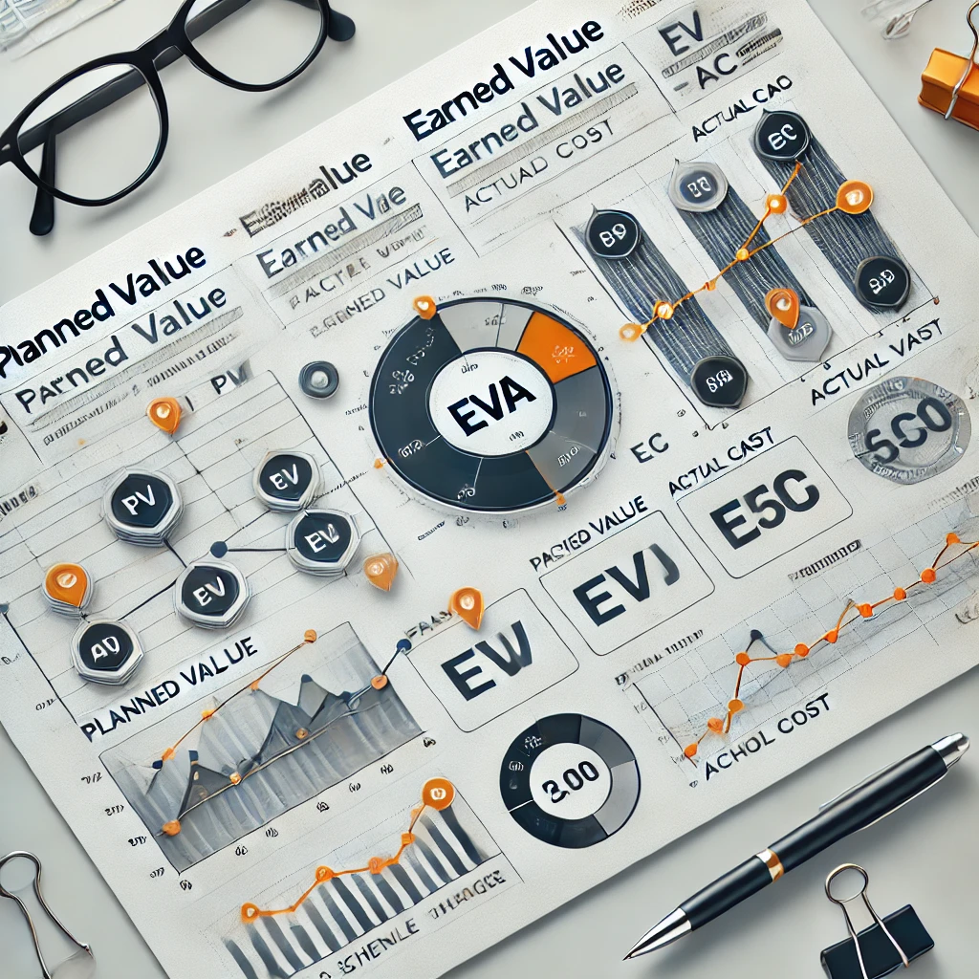
Earned Value Analysis (EVA):
Earned value analysis is a project management technique that integrates scope, schedule, and resource measurements to assess project performance. It compares the value of work completed (earned value) with the planned value and actual cost, providing insights into project progress, efficiency, and cost-effectiveness.

Slide 8
Importance of EVA:
Eva is crucial because it:
Enhances project visibility and transparency
Provides accurate project status and performance metrics
Identifies variances and deviations from plans
Facilitates timely corrective actions and decisions
Improves project control, efficiency, and productivity
Supports effective resource allocation and utilization
Increases stakeholder confidence and trust

Slide 9
Purpose:
The primary purpose of EVA is to:
Track project progress and performance
Identify and address deviations from plans
Optimize resource allocation and utilization
Improve project efficiency and productivity
Enhance decision-making and corrective actions
Ensure project deliverables meet scope, schedule, and budget requirements
Provide reliable data for project forecasting and risk management

Slide 10
Earned Value Management (EVM):
1. Earned Value (EV): The value of work completed, expressed in currency or percentage.
2. Planned Value (PV): The planned cost or value of work scheduled.
3. Actual Cost (AC): The actual cost incurred for completed work.
4. Cost Variance (CV): The difference between EV and AC.
5. Schedule Variance (SV): The difference between EV and PV.
6. Performance Index (PI): A measure of project efficiency, calculated as EV/AC.
Earned Value Analysis Techniques:
1. Calculating Earned Value: EV = (Percentage Complete) x (Planned Value)
2. Determining Planned Value: PV = (Planned Cost) x (Scheduled Percentage)
3. Calculating Actual Cost: AC = Actual expenditures
4. Calculating Cost and Schedule Variances: CV = EV - AC, SV = EV – PV
5. Interpreting EVA metrics: Discuss how to analyze and use EVA data.

Slide 11
Benefits of Earned Value Analysis:
Improved project visibility: EVA provides accurate project status.
Enhanced cost control: EVA helps identify cost variances.
Better schedule management: EVA tracks schedule performance.
Increased stakeholder confidence: EVA provides reliable project data.
Early detection of project issues: EVA identifies potential problems.
Challenges and Limitations of EVA:
Data accuracy and quality: EVA relies on accurate data
Complexity of EVA calculations: Calculations can be intricate
Difficulty in establishing baseline: Setting a realistic baseline is crucial
Integrating EVA with existing PM systems: EVA may require system adjustments
Overcoming organizational resistance: Stakeholders may resist EVA adoption.

Slide 12
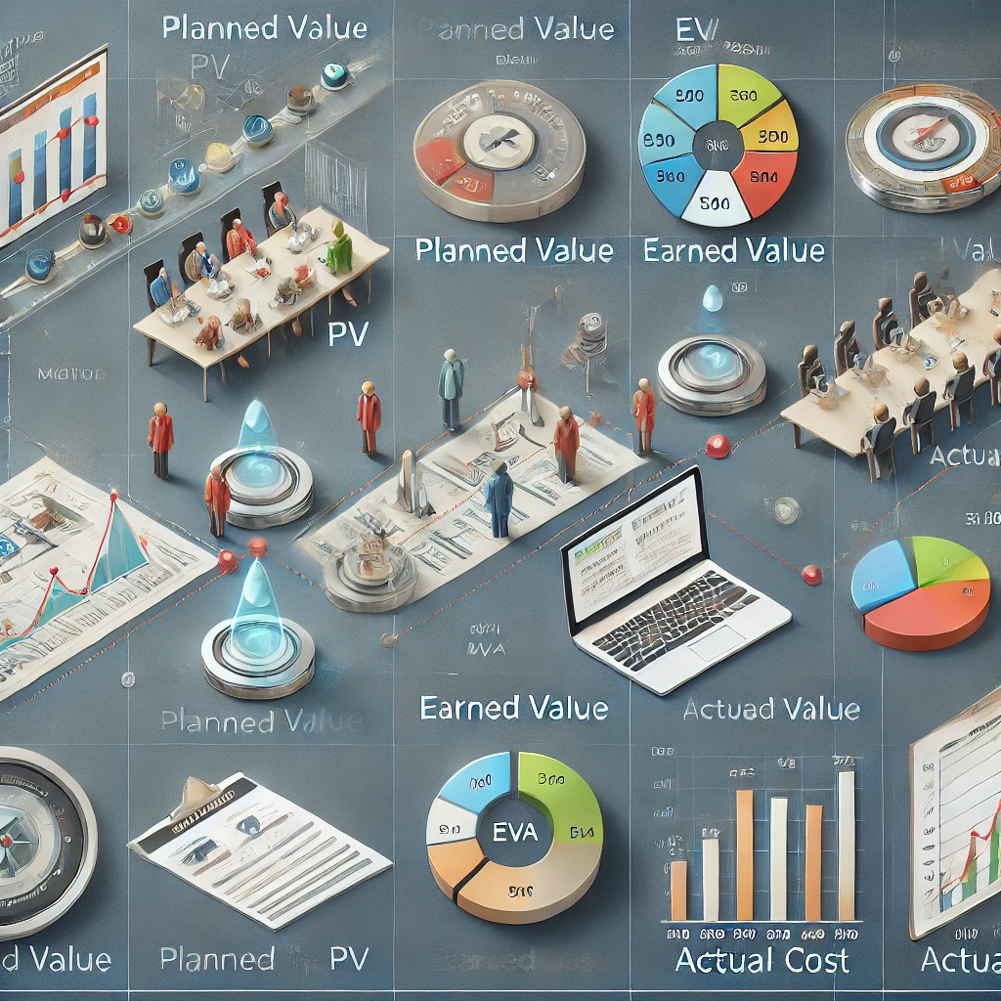

Slide 13
Example Of real World
Construction of a New Office Building
Project duration: 12 months
Total budget: $1.5 million
Scope: Construct a 2-story office building with 10,000 sq. ft. of usable spaceProject Breakdown Structure (PBS)1. Site preparation (10% of total budget)2. Foundation work (20% of total budget)3. Framing and structural work (30% of total budget)
4. Installation of electrical, plumbing, and HVAC systems (20% of total budget)
5. Finishing work (20% of total budget)Earned Value Analysis (EVA)Assume the project is currently 6 months into construction. The project manager wants to perform an EVA to assess project performance.
Actual Data
Actual cost (AC): $900,000 (spent so far)
2. Percentage complete: 50% (based on progress reports)
Planned Value (PV)
Total budget: $1.5 million
2. Planned percentage complete: 50% (based on project schedule)

Slide 14
Earned Value (EV)
EV = (Percentage complete) x (Total budget): $750,000 (50% x $1.5 million)Calculations
Cost Variance (CV):
EV - AC = $750,000 - $900,000 = -$150,000 (cost overrun)
Schedule Variance (SV):
EV - PV = $750,000 - $750,000 = $0 (on schedule)
Cost Performance Index (CPI):
EV/AC = $750,000 / $900,000 = 0.83 (inefficient)
Schedule Performance Index (SPI):
EV/PV = $750,000 / $750,000 = 1.00 (on schedule)
Interpretation
The project is experiencing a cost overrun of $150,000.
The project is on schedule
The cost performance index (CPI) indicates inefficient use of resources.
The schedule performance index (SPI) indicates the project is on schedule

Slide 15
THANK YOU ☺

